Slide 1



Robotics Triathlon Performance Presentation
By: Anthony Tucci, Sean Fritz, and Manar Elkader

Slide 2
Throughout the project, our group was presented with several problems we needed to overcome:
The frictionless surface on which we had tested the robot had presented inconsistencies in its performance.
Outputs of the Sphero Robot would differ despite the block code and setup remaining the same. We believe this to be caused by the battery life of the robot dropping beyond a certain threshold
Team member's schedules were often conflicted with one another, leading to difficulty meeting up and communication ideas with one another

Slide 3
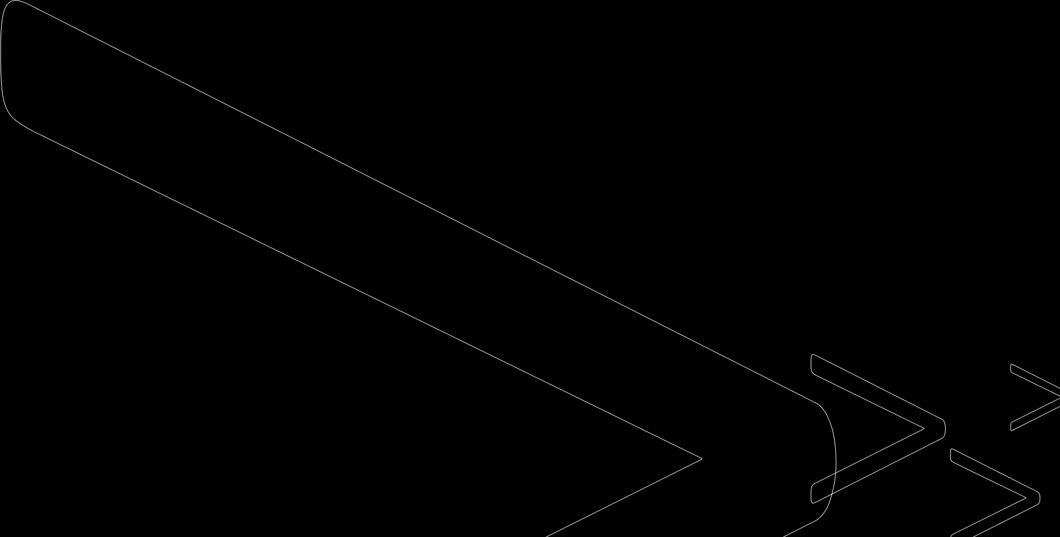
During project development, each team member worked a variety of different roles:
Anthony: Programming, Algorithm Design, Test Table Documentation, System Design Document Management
Sean: Programming, Algorithm Design, Flowchart Design, Test Table Documentation, Sensor Data Analysis, Staffing Plan Coordinator, Videographer, System Design Document Management
Manar: Programming, Flowchart Design, Videographer, System Design Document Management

Slide 4
What has our group learned about Software Engineering while working on this project?
Software Engineering requires frequent collaboration, communication, patience, and organization among all members of a team
A successful execution of an idea or project is not as important as having a consistent output
Performance can be negatively affected by a number of different variables, including environmental hazards, robot-related bugs, or human error
Frequent testing during the process of development is a necessity in order to see if your current work presents unforeseen problems

Slide 5
If we could redo the project, we would make the following changes:
Set dates ahead of time to work on the project. This would ensure that all group members were present during the crucial stages of development and testing.
Make use of the classroom at an earlier date to avoid a crowd of groups testing their robot last-minute.
Spend more time formatting the SDD, so that simple mistakes do not get missed during the process of writing and checking.

Slide 6
Sprint #3 (Agility) Block Code

Slide 7
Sprint No. 3 (Agility): Our robot in action:
[Attach the video from the GitHub to this slide]

